Slide 1
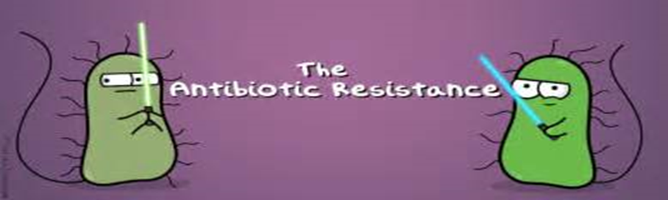
Antibiotic Drug Resistance
Rupal Shah, PharmD.

Slide 2
Objectives
Define antibiotic resistance and discuss concerns associated with the increase of resistant strains
Review CDC guidelines and explore which patients may warrant antibiotic treatment.
Describe current efforts to reduce improper antibiotic prescribing
Discuss health plan’s role in helping reduce antibiotic resistance
Notes:
.

Slide 3
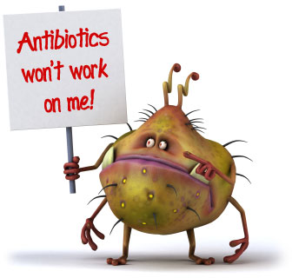
What is Antibiotic Resistance?
The ability of bacteria to resist the effects of drugs
Resistant bacteria survive exposure to antibiotics and continue to multiply in the body, potentially causing more harm and spreading to other animals or people.
Notes:
What is antibiotic resistance?
Well…. Over time, many infectious organisms have adapted to the drug therapies we have developed to eradicate them, making the products less effective. Because most bacteria, viruses, and other microbes can multiply rapidly, they quickly evolve and develop resistance to antimicrobial drugs that we have designed to kill them
Hence.. The term Antibiotic resistance

Slide 4
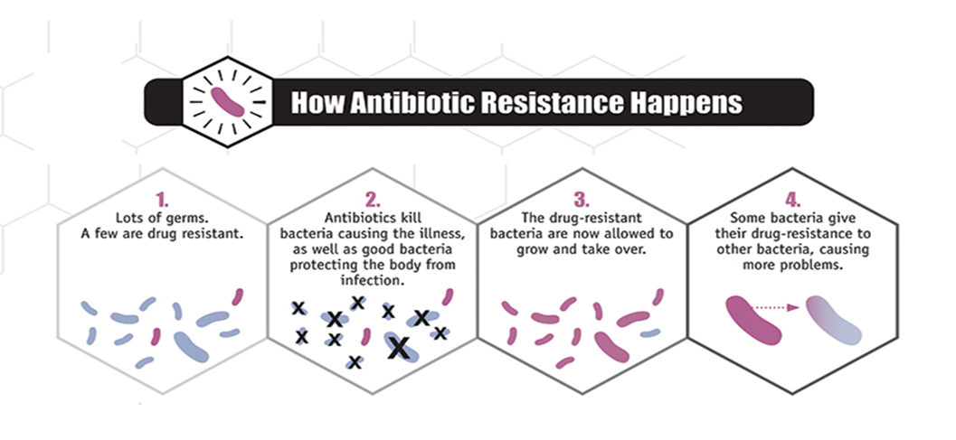
How do bacteria become resistant to antibiotics?
Selective Pressure - In the presence of an antibiotic, microbes are either killed or, if they carry resistance genes, survive. These survivors will replicate, and their progeny will quickly become the dominant type throughout the microbial population.
Notes:
Now How have the bacteria evolved ?
In the presence of an antibiotic, microbes are killed, but if they carry resistance genes they will survive. These survivors will replicate , Making them the dominant type and the sole survivors throughout the microbial population.
Centers for Disease Control and Prevention website. https://www.cdc.gov/drugresistance/threat-report-2013/pdf/ar-threats-2013-508.pdf. Accessed October 2, 2017.

Slide 5
Why do we care?
Causes more than 2 million illnesses per year ¹
Kills at least 23,000 people in the US alone yearly ¹
Estimated 300,000 deaths in North America by 2050
Adds an estimated $20 to $35 billion in excess direct healthcare costs (2008 dollars) ¹
^{1.} Centers for Disease Control and Prevention website. https://www.cdc.gov/drugresistance/threat-report-2013/pdf/ar-threats-2013-508.pdf. Accessed October 2, 2017.
Notes:
(source CDC 2013)
And the complication of allowing these Drug resistant microorganisms to proliferate…well you can see for your self.
Antibiotic resistance has caused more than 2 million illnesses per year and killed 23,000 people in the US alone
•A recent study stated that, by 2050, mortality rates will continue to dramatically rise to about 300,000 if antibiotic resistance isn't addressed now
And it adds about 20 to 35 billion dollars in excess health care costs

Slide 6
Why do we care?
Antibiotic resistance is present in every country
Notes:
And antibiotic resistance is present in every country!!! so it is Not only a national issue, but a global issue
the director from the WHO said
"this serious threat is no longer a prediction for the future, it is happening right now in every region of the world and has the potential to affect anyone, of any age, in any country.”
So over all : Antibiotic resistance leads to longer hospital stays, higher medical costs and increased mortality not only in the US but all over the world

Slide 7
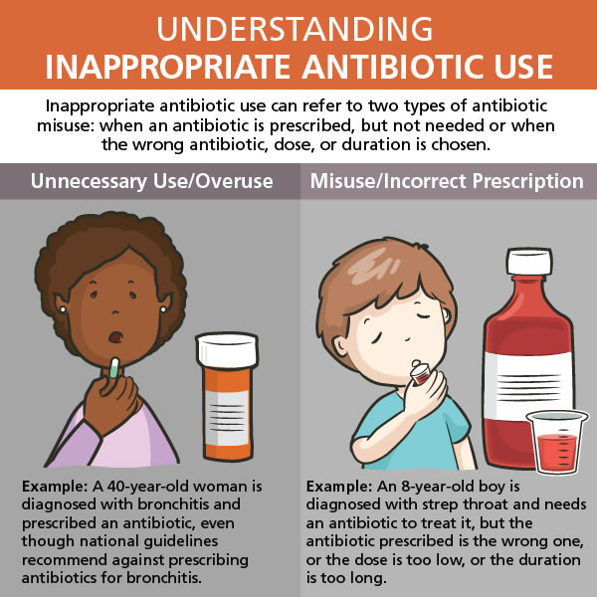
How is it spread?
Inappropriate Use or Overuse - 50% of all antibiotic courses prescribed are unnecessary or not optimally effective as prescribed. ¹
Notes:
Antibiotic resistance occurs naturally, but misuse or over use of antibiotics in humans and animals is what is accelerating the process
50% of all antibiotics prescribed are unnecessary or not effective as prescribed
The reasons clinicians are prescribing antibiotics are not ideal. Studies have indicated more than half of patients received an antibiotic regardless of the reason for their hospitalization

Slide 8
How is it spread? (cont.)
Hospital Use
  Critically ill patients are more susceptible to infections. However, the heavier use of antibiotics in these patients can worsen the problem by producing bacteria with even greater ability to survive in the presence of our strongest antibiotics
  Half of hospitalized patients received at least 1 dose of antibiotics during their stay
Notes:
It is also spread by overuse in our Hospitals
It is true that our Critically ill patients are more susceptible to infections and often actually need the help of antibiotics. However, the heavier use of antibiotics in these patients can worsen the problem by producing bacteria with even greater ability to survive in the presence of our strongest antibiotic such as vancomycin.

Slide 9

How is it spread? (cont.)
Agricultural Use - The practice of adding antibiotics to agricultural feed promotes drug resistance
Animal feed- Mixed with antibiotics to prevent infections and promote growth
Notes:
Another factor in the growth of antibiotic resistance that many don’t think of is the spread from the non-human sources in the environment such as food. ABX are added to both agricultural and animal feed to prevent infections and promote growth

Slide 10
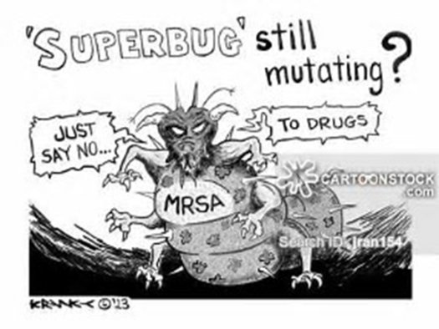
Implications
Unnecessary exposure diminishes future effectiveness
Increased risk of adverse events such as C. difficile
Increased drug-drug interactions
Emergence of multidrug resistance bacteria
Notes:
Every time a person takes antibiotics, sensitive bacteria are killed, but resistant bacteria are left to grow and multiply. This is how repeated use of antibiotics can increase the number of drug-resistant bacteria. Makes it difficult to find an antibiotic to fight an infection and can lead to treatment failure and death .
In addition to driving drug resistance, these poor practices introduce unnecessary side effects, allergic reactions, and serious diarrheal infections caused by Clostridium difficile. These complications of antibiotic therapy can have serious outcomes

Slide 11
The World is Running Out of Antibiotics
World Health Organization (WHO) in September 2017 released a report that identifies 51 new antibiotics and biologicals in clinical development to treat priority antibiotic resistance… Among all these only 8 are classed by WHO as innovative treatments that will add value
Notes:
Antibiotic resistance is rising to dangerously high levels in all parts of the world. New resistance mechanisms are emerging and spreading globally, threatening our ability to treat common infectious diseases. A growing list of infections – such as pneumonia, tuberculosis, blood poisoning, gonorrhoea, and foodborne diseases – are becoming harder, and sometimes impossible, to treat as antibiotics become less effective.
Due to this The CDC has put together a watch list to keep track of the threat levels as they grow.

Slide 12
Top 18 drug resistance threats – URGENT!
Clostridium difficile (C. diff)
Carbapenem-Resistant Enterobacteriaceae (CRE)
Neisseria gonorrhoeae (cephalosporin resistance)
Notes:
Among all of the bacterial resistance problems, gram-negative pathogens are particularly worrisome, because they are becoming resistant to nearly all drugs that would be considered for treatment. This is true as well, but not to the same extent, for some of the gram-positive infections (e.g., Staphylococcus and Enterococcus). The most serious gram-negative infections are healthcare-associated, and the most common pathogens are Enterobacteriaceae, Pseudomonas aeruginosa, and Acinetobacter.

Slide 13
Top 18 drug resistance threats - Serious
  Multidrug-Resistant Acinetobacter
  Drug-Resistant Campylobacter
  Fluconazole-Resistant Candida
  Extended Spectrum Enterobacteriaceae (ESBL)
  Vancomycin-Resistant Enterococcus (VRE)
  Multidrug-Resistant Pseudomonas Aeruginosa
  Drug-Resistant Non-Typhoidal Salmonella
  Drug-Resistant Salmonella Serotype Typhi
  Drug-Resistant Shigella
  Methicillin-Resistant Staphylococcus Aureus (MRSA)
  Drug-Resistant Streptococcus Pneumoniae
  Drug-Resistant Tuberculosis
Notes:
The resistance threat categorized as serious has the most number microorganisms under it. The organisms on this list are not yet an urgent level but have the possibility of getting there. I want to point out an example that is very common in practice, the use of Fluconazole for Candida which has been 1st line treatment but now due to the serious level of tis antifungal in this case it may get to the point where we wont be able to use/puts 1st line treatment due to increased risk of drug resistance. any more due to drug resistance. for several years now as well as MRSA and VRE.

Slide 14
Top 18 drug resistance threats - Concerning
Vancomycin-Resistant Staphylococcus Aureus
Erythromycin-Resistant Group A Streptococcus
Clindamycin-Resistant Group B Streptococcus
Notes:
Lastly these are the last 3 that the cdc states are at concerning levels. For these 3 organisms we still have therapeutic options available to treat them placing them at a lower hazard level in comparison to the others.

Slide 15
What are we doing now?
Four Core Actions to Fight Resistance ¹
  Prevent infections
  Tracking
  Improve antibiotic prescribing
  Developing new drugs and diagnostic tests.
Notes:
All these increasing hazard levels have led to the formation of Antimicrobial Stewardship programs. Effective January 2017, the Joint commission turned the recommendation into a requirement that made ALL hospitals and nursing care centers to have antimicrobial steward ship programs . This regulation also applied to outpatient facilities and clinics associated with the hospital. The primary goal is to optimize clinical outcomes while minimizing the unintended consequences of antibiotic use esp in out patient settings.
The majority of antibiotic use occurs in outpatient settings, making this a critical target of the program. In the United States in 2011, more than 260 million courses of antibiotics were prescribed in the outpatient setting with diagnoses of respiratory tract, skin, and urinary tract infections being the most common
The key element of the Antimicrobial steward ship program states that There are four core actions that will help fight these deadly infections:
■■ preventing infections and preventing the spread of resistance
■■ tracking resistant bacteria
■■ improving the use of today’s antibiotics
■■ promoting the development of new antibiotics and developing new diagnostic tests for resistant bacteria
Now I have already mentioned how there is a lack in innovative drugs to fight drug resistance and talked about how the cdc has been tracking the hazard levels. Now I want to focus mainly on the prevention and improving abx prescribing

Slide 16
Prevention
Promote good hygiene by regular hand washing and preparing food hygienically
Healthcare professional – ensure instruments and environment are clean
Vaccines
  ACIP recommends that FluMist Quadrivalent (LAIV4) NOT be used during the 2017–18 season (it was found not to work very well).
Notes:
This includes basic self care such as washing hands, staying home when you’re sick, preparing food in a healthy manner,
If you’re a healthcare professional – it may mean keeping the work environment sanitary
And for everyone keeping up to date with your vaccines and checking the guidelines for any changes,
For example, I’m not sure how many practioners are aware but ACIP no longer recommends the intranasal administration of FLUMIST due to its lack of efficacy for the 2017 flu season

Slide 17
Improve Antibiotic prescribing
Identify barriers/high priority conditions-those for which clinicians commonly deviate from best practices.
Establish standards for antibiotic prescribing
Use watchful waiting with conditions that usually resolve without treatment
Notes:
We can do this By identifying barriers or high priority conditions that deviate from best practices for antibiotic prescribing; they include conditions for which antibiotics are
overprescribed or misprescribed
Examples are
Conditions for which antibiotics are not indicated such as acute bronchitis, the common cold, other nonspecific upper respiratory infection or viral pharyngitis which we will revisit later during this presentation
OR
Identify barriers such as knowledge gaps about clinical practice guidelines or the providers perception of patient expectations regarding antibiotics
Providers' perceptions of patients' desire to receive antibiotics are often incorrect. In one survey performed by the CDC, 54 percent of providers believed their
patients expected to receive antibiotics during visits for a cough or cold, while only 26 percent of patients actually had such an expectation
Communication training, including shared decision-making, can help prescribers avoid unnecessary antimicrobial prescribing
Another way to improve prescribing is to USE Establish protocols for antibiotic prescribing that might include national guidelines to set clear expectations for appropriate antibiotic use. Providers frequently prescribe antibiotics for a longer duration than necessary, Guidelines can promote the shortest effective duration supported by evidence in order to limit unintended consequences. Pharmacist review of prescriptions could facilitate the preferred duration of therapy
Also
Use watchful waiting or delayed prescribing for patients with conditions that usually resolve without treatment but who can benefit from antibiotics if symptoms do not improve. it may be beneficial for providers during this time to provide education regarding adverse effects of antibiotics as well as to offer guidance regarding alternative forms of symptomatic relief

Slide 18
Do Health Plans Have a Role In Limiting Antibiotic Resistance?
CDC calls antibiotic resistance the world’s most pressing public health threat, saying it requires collaborative action from all stakeholders: physicians, hospital administrators — and health plans
According to the National Committee for Quality Assurance (NCQA)-Managed care organizations have an important role in collecting data that hospitals, nursing homes, and physicians can use to manage antibiotics
Notes:
https://www.managedcaremag.com/archives/2014/4/do-health-plans-have-role-limiting-antibiotic-resistance
So this is what the CDC, WHO, and all the other organizations out there have come up with to combat Antibiotic resistance. We have seen how doctors and patients can directly contribute to decrease the spread of antibiotic resistance. Now the question is where does Managed care organizations fit in and do they have a role in all of this?
According the NCQA- Managed care orgs has the most important job of collecting data on how these antibiotics are being used. Tracking and reporting clinician antibiotic prescribing can guide changes in practice and be used to assess progress in improving antibiotic prescribing.
hence, they came up with 4 hedis measures to grade the health plans

Slide 19
Healthcare Effectiveness Data and Information Set (HEDIS) Measures
HEDIS measures having to do with ABX:
Avoidance of Antibiotic Treatment in Adults With Acute Bronchitis (AAB)
Appropriate Treatment for Children With Upper Respiratory Infection (URI)
Appropriate Testing for Children with Pharyngitis (CWP)
Antibiotic Utilization
Notes:
So I know I briefly mentioned some of these earlier when I was talking about high priority conditions. These are the 4 current measures related to antibiotic prescribing. The 1st three are high priority because they are accreditation measures for health plans and are what I am going to be going into more detail on .

Slide 20
Avoidance of Antibiotic Treatment in Adults with Acute Bronchitis
Assesses adults 18˗64 years of age with a diagnosis of acute bronchitis who were not dispensed an antibiotic prescription (a higher rate is better).
Current guidelines recommend against antibiotic treatment for acute bronchitis in adults who are healthy because:
  Overuse can lead to antibiotic resistance
  Avoid harmful side-effects
Notes:
Avoidance of Antibiotic Treatment in Adults with Acute Bronchitis
This HEDIS Measure
Assesses adults 18-˗64 years of age with a diagnosis of acute bronchitis who were NOT dispensed an antibiotic prescription (a higher rate is better).
The reason this is an important measure is because
Antibiotics cost the health care system billions of dollars each year, and treating conditions such as acute bronchitis adds to the cost. Current guidelines recommend against antibiotic treatment for acute bronchitis in adults who are otherwise healthy because overuse can lead to antibiotic resistance.3
Acute bronchitis almost always gets better on its own; therefore, adults who do not have other health problems should not take antibiotics. Ensuring the appropriate use of antibiotics for patients with acute bronchitis will help them avoid harmful side-effects and possible resistance to antibiotics over time.
The chart on the right shows the rate at which pt were not prescribed abx for this population is around 28% and fast forward 9 years later it is still at the same level.
Which goes to show much more work in this area is needed…

Slide 21
Appropriate Treatment for Children with Upper Respiratory Infection
Assesses children 3 months˗18 years of age who were given a diagnosis of upper respiratory infection (URI) and were not dispensed an antibiotic prescription. A higher rate indicates appropriate treatment of children with URI
Also known as the common cold- caused by viruses that require no antibiotic treatment
Notes:
The next measure asses children from 3 months to 18 year olds who were given a diagnosis of upper respiratory tract infection also known as the common cold. As I am sure many of you know is a viral infection, where the use of antibiotics wont help.
As can be seen in 2004 roughly 82% were not prescribed an antibiotic which is great. However with all the ongoing efforts it only rose about 6% by 2015 in the HMO plan.

Slide 22
Appropriate Testing For Children With Pharyngitis
Assesses children 2˗18 years of age who were diagnosed with pharyngitis, dispensed an antibiotic and received a group A streptococcus test for the episode. A higher rate represents better performance
Viral pharyngitis does not require antibiotic treatment, but antibiotics continue to be inappropriately prescribed. Proper testing and treatment of pharyngitis would prevent the spread of sickness, while reducing the unnecessary use of antibiotics
Notes:
The 3rd assess children 2- 18 years old who are diagnosed with pharyngitis. Now pharyngitis can be either viral or bacterial . Proper testing and treatment of pharyngitis would prevent the spread of sickness, while reducing the unnecessary use of antibiotics. So this measures asks for those diagnosed with pharyngitis to receive a A Streptococcus test before the antibiotic is dispensed for confirmation that it is indeed bacterial
This resulted in a jump of 10% in the commercial HMO Plans and an even larger increase with the Medicaid population .

Slide 23
AWARE
Physicians over prescribing are sent an AWARE tool kit which includes:
  Pediatric guideline
  Adult guideline
  Prescription pad
  CDC flyers and patient education material
In 2017 UTI guidelines have been added to toolkit in addition to the adult URI guideline summary
Notes:
Along with keeping track of all these measures what else are we doing?
Health net has formed a partnership with Aware which stands for the Alliance Working for Antibiotic Resistance Education (AWARE) which was initiated by the California Medical Association in 2000, as a long-term statewide effort to promote the appropriate use of antibiotics.
The AWARE program uses numerous methods to reduce unnecessary antibiotic use. Each year an expert clinical work group meets to develop timely educational materials regarding appropriate antibiotic use for adult and pediatric care and put this along with fliers and educational material in an AWARE Toolkit. The CMA Foundation mails these Toolkit materials to high-prescribing physicians to promote adherence to appropriate prescribing guidelines
This year UTI was added to the tool kit bc it has been a growing issue

Slide 24
Possible Interventions
Prior authorization- restrict the use of certain antibiotics based on the spectrum of activity, cost, or associated toxicities to ensure that use is reviewed with an antibiotic expert before therapy is initiated
  Do not want to restrict the appropriate use of antibiotics.
Letters mailings-writing to physicians to counsel patients about the appropriate use of antibiotics.
  sending letters after the fact may not have as strong an effect
Notes:
What else can we do as a managed care organization? We have already seen in prior slides that the rate of changed was unaffected or minimally affected with monitoring and increased efforts nationwide.
Some propose more Pa’s to restrict the use of antibiotics; however restricting the use of antibiotics could inhibit a person from receiving proper care when an antibiotic is most needed
Other methods include letter mailings to counsel physicians about appropriate use; however sending letters after the fact may not have as strong as an effect

Slide 25

“Nudging” Physicians- A USC study
Researchers at USC studied a psychological approaches known as "nudges" on 248 physicians
Intervention 1: "peer comparison" in which physicians were updated by a monthly email about their rate of inappropriate prescribing and informed whether they were a "top performer" in comparison to their peers.
Intervention 2: "accountable justification" required clinicians to report the reason for prescribing antibiotics in the patient's record.
The interventions prevented 1 inappropriate prescription for every 8 patients
What would happen when the interventions were removed? Would bad habits return?
The study shows that 12 months after the peer comparison intervention had ended, clinicians increased their antibiotic prescription rate from 4.8% to 6.3%
Notes:
http
http://www.healthcarefinancenews.com/news/physicians-need-nudging-change-old-prescribing-habits
s://www.mdlinx.com/family-medicine/top-medical-news/article/2017/10/13/7474362?utm_source=in-house&utm_medium=message&utm_campaign=epick-mix-oct13
An interesting study was conducted by Researchers at USC who studied a psychological approaches known as "nudges" on 248 physicians
Intervention 1: "peer comparison" in which physicians were updated by a monthly email about their rate of inappropriate prescribing and informed whether they were a "top performer" in comparison to their peers.
Intervention 2: "accountable justification" required clinicians to report the reason for prescribing antibiotics in the patient's record.
The interventions resulted in the prevention of 1 inappropriate prescription for every 8 patients
Then they asked What would happen when the interventions were removed? Would bad habits return?
The study shows that 12 months after the peer comparison intervention had ended, clinicians increased their antibiotic prescription from 4.8 to 6.3 %
Given the low cost of the interventions, the researchers said it may make sense for clinicians to adopt them permanently.
They also suggested that this enduring effect from peer comparison may be because this intervention did not rely on electronic medical record prompts. BUT because physicians may have made "judicious prescribing part of their professional self-image" after the study.

Slide 26
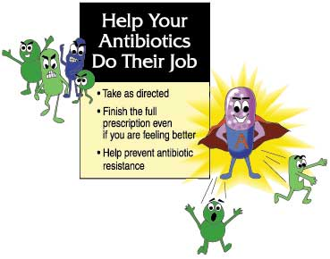
How you can help
Educate patients to:
  Not skip doses.
  Complete the prescribed course of treatment
  even if they are feeling better.
  Be aware of the expected response to treatment
  and notify the prescriber if that expected response is not occurring.
Encouraging patients to use the antibiotic as instructed.
Notes:
https://www.cdc.gov/drugresistance/protecting_patients.html
I know we talked a lot about avoiding antibiotic therapy. Now what can we do to help when antibiotic therapy is needed.

Slide 27
How you can help
Prescribing an antibiotic only when it is likely to benefit the patient.
Prescribing an antibiotic that targets the bacteria that is most likely causing their patient’s illness when an antibiotic is likely to provide benefit.
Collaborating with each other, office staff, and patients to promote appropriate antibiotic use.
Notes:
As providers

Slide 28
Common URI Infections
Notes:
Here is a good over view of the common Upper respiratory tract infections seen during the winter months. I want to focus on the benefits section that is stared and you’ll notice 2 of the 4 columns will have little or no benefit when an antibiotic is prescribed. The only one is pharyngitis. And that is only if they have a streptococcal infection
Many of the common symptoms you see in this table are things we observe in practice, but we need to realize that perhaps the patient may benefit the most from just simple self care, rest, and relaxation to resolve the issue

Slide 29
How you can help
Continue reviewing and following the latest clinical practice guidelines for common infections, such as CDC's Adult and Pediatric Academic Detailing Sheets.
Click on the following link:
  CDC guidelines
Notes:
I would like to encourage clinicians to continue reviewing guidelines recommendations for changes and updates. .The guidelines are posted on the CDC site.

Slide 30
Surveillance of Antimicrobial Resistance
"Antimicrobial resistance is a global health emergency that will seriously jeopardize progress in modern medicine.”
- Dr. Tedros Adhanom Ghebreyesus, Director of WHO
“The most expensive antibiotic is the one that does not work!”
Notes:
WHO Vision
The most expensive antibiotic is the one that does not work.” – Unknown

Slide 31
Resources
1.Centers for Disease Control and Prevention website. https://www.cdc.gov/drugresistance/threat-report-2013/pdf/ar-threats-2013- 508.pdf. Accessed October 2, 2017.
2. World Health Organization website. http://www.who.int/mediacentre/factsheets/fs194/en/. Accessed October 5, 2017.
3. Center for Disease Control and Prevention website. https://www.cdc.gov/getsmart/community/about/antibiotic-resistance- faqs.html. Accessed October 2,2017.
4. National Institute of Allergy and Infectious Diseases (NIAID) website.
https://www.niaid.nih.gov/research/antimicrobial-resistance. Accessed October2,2017
5. Infectious Disease Society of America (IDSA) website. http://www.idsociety.org/View_All_Antimicrobial_Resistance__for_Professionals/. Accessed October 6, 2017.
6. Alliance for Prudent use of Antibiotics (APUA) websites.
http://emerald.tufts.edu/med/apua/about_issue/about-the-issue---the-cost-of-resistance.shtml. Accessed October 6, 2017
7. Lagasse, J. Physicians need nudging to change old prescribing habits. October 2017. Available from: http://www.healthcarefinancenews.com/news/physicians-need-nudging-change-old-prescribing-habits. Accessed November 2017.
8. Holubar, Marisa, et. Al. Antimicrobial stewardship in outpatient settings. Uptodate. Waltham,MA:UpToDate Inc. http://www.uptodate.com Accessed December 5, 2017.

