Slide 1

Spinal Muscular Atrophy
(SMA)
Sheta Ara, Pharm.D., BCGP, BCMTMS
September 2, 2020

Slide 2
Objectives
Overview of Spinal Muscular Atrophy (SMA)
Explain the differences between SMA types
Discuss the complications and impact of SMA
Review current drug therapies approved for the treatment of SMA

Slide 3
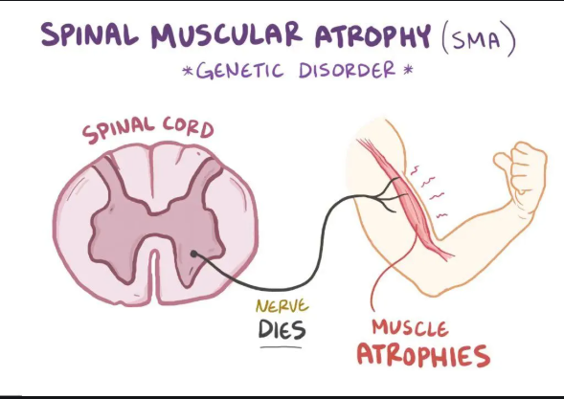
What is Spinal Muscular Atrophy (SMA)?
Rare, degenerative neuromuscular disease characterized by progressive muscle weakness and atrophy
Leading genetic cause of infant death
Estimated incidence of SMA in the United States is 1 in 11,000 live births
Estimated prevalence is around 1 to 2 in 100,000 persons
Notes:
Degenerative neuromuscular disease that affects the motor neurons in the spine and lower brain stem that power the muscles in the body resulting in progressive muscle weakness and atrophy

Slide 4
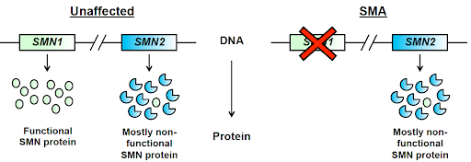
Pathophysiology
Survival motor neuron (SMN) proteins facilitate proper signaling between CNS motor neurons and muscles in the body
SMA is an autosomal recessive condition caused by deletions or mutations in the SMN1 gene, resulting in a shortage of SMN protein
  SMN2 gene produces a small amount of functional length SMN protein, and an increase in copy number may decrease severity of disease but cannot fully compensate for the loss-of-function of SMN1
Notes:
BULLET 1: SMN proteins are integral to maintaining muscle strength and prevention of atrophy

Slide 5
SMA Types
SMA Type Prevalence | SMN2 copies | Age of Onset | Features
Type 1 (~60%) | 2 – 3 | Birth – 6 months | Flaccid paralysis, rapid progression of symptoms Weak cry, poor suck/swallow reflex, aspiration risk Progressive respiratory failure, paradoxical breathing Most die before 2 years of age
Type 2 (~ 20%) | 3 | 3 – 15 months | Often able to achieve sitting unassisted, but not independent standing/walking Restrictive lung disease, scoliosis, respiratory muscle weakness, and dysphagia Lifespan variable
Type 3 (~30%) | 3 – 4 | 18 months – adult | Often achieve ambulation, but potential loss of ability to stand/walk independently over time Limited scoliosis and/or respiratory muscle weakness Normal lifespan
Type 4 (<5%) | 4+ | Late onset | All motor milestones achieved Normal lifespan

Slide 6
Complications and Impact
Respiratory
  Potential dependence on cough assist devices, BiPAP (bilevel positive airway pressure)/CPAP (continuous positive airway pressure) machines, ventilator/tracheostomy
Feeding/Nutrition
  Impacted ability to feed self and swallow, risk of aspiration, and potential progression to G-tube/gastric button
Activities of daily living (ADL)
  Potential loss of ability to live independently, may become reliant on home health nursing, DME (durable medical equipment) use, other assistance
Decline in motor function abilities

Slide 7


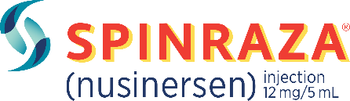
Spinal Muscular Atrophy Treatments
FDA Approved | December 23, 2016 | May 24, 2019 | August 7, 2020
Route of Administration | Intrathecal Injection | Intravenous Infusion | Oral Solution
Frequency | Initial: every 2 weeks for three doses, then 4th loading dose 4 weeks after 3rd dose Maintenance: every 4 months | One-time | Once daily
Estimated Cost | $125K/dose | $2.125 mil/yr | $407,705
Notes:
Estimated annual cost calculated based on AWP (from Medispan) averaged over a 5 year time period (assuming new start):
- Spinraza 5mL (2.4 mg/mL): $153,000 (1 x 12mg dose)
$918,000 for the first year (assuming 6 doses) then $459,000 (assuming 3 doses annually for maintenance) for each subsequent year
Total = First 5 years: $2,754,000 ($550,800/yr) / 5 years of maintenance: $2,295,000 ($459,000/yr)
Zolgensma: $2,550,000
$510,000/year x 5 years
Evrysdi 80mL (0.75mg/mL): 13,404 (assumed max dose, 5 mg daily)
[(5mg daily x 365)/0.75 mg/80 mL] x 13,404 = $407,705 (based on AWP from Medispan); mention listed internet price by Roche (max per year ~ $340,000) but we do not know how or from what sources this pricing is based on/ME email price
Per Dr. Shore:
Spinraza - $153K/dose instead of $125K/dose ($918K for the first year vs. $750K, and $459K/year after that vs. $375/year)
Zolgensma - $2.55M instead of $2.125M

Slide 8
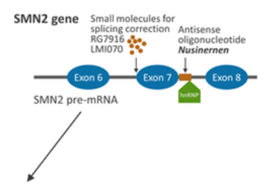
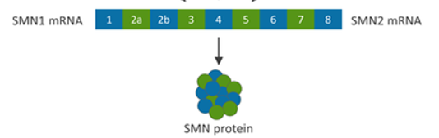
Spinraza ® (nusinersen)
Mechanism of Action: survival motor neuron-2-directed antisense oligonucleotide that increases exon 7 inclusion in SMN2 messenger ribonucleic acid (mRNA) transcripts to produce full-length SMN protein
Indication: treatment of SMA pediatric and adult patients
Dose: 12mg intrathecally every 14 days for first 3 loading doses, then 4th loading dose 30 days after 3rd dose, then a maintenance dose once every 4 months

Slide 9
Summary of Clinical Trials – Spinraza
Infantile-Onset
 | ENDEAR
Design | Phase 3, randomized, double-blind, placebo-controlled
# of patients | SMA Type 1, N = 121
Age Range | 7 months of age and younger
Results | 51% treated vs 0% untreated were motor milestone responders at 9 months HINE-2: head control, rolling, independent sitting, standing 63% reduced risk of mortality in Spinraza group
Status | Completed
Notes:
ENDEAR was a 13-month study in 121 children 7 months of age and younger with Type 1 (early-onset) SMA. It was a randomized, sham-controlled study, which means children were randomly placed into a treated or untreated group.
The study evaluated the effect SPINRAZA has on survival without permanent ventilation and the proportion of “responders,” or children who showed an improvement in motor milestones, according to an assessment scale called HINE-2.

Slide 10
Summary of Clinical Trials – Spinraza
Late-Onset
 | CHERISH | CS2/CS12
Design | Phase 3, randomized, double-blind, placebo-controlled | Open-label, 3-year study
# of patients | SMA Type 2/3, N = 126 (84 treated; 42 untreated) | SMA Type 2, N = 21 SMA Type 3, N = 7
Age Range | 2 – 9 years old | 2 – 16 years old
Results | Spinraza treated group improvements over 15 months RULM: 4.2 points treated vs. 0.5 points untreated HFMSE: 3.9 points treated vs. – 1 point untreated | Type 2: 4 point increase from baseline in upper limb function (ULM) 10.8 point increase from baseline in motor function (HFMSE) 1 gained ability to walk Type 3: 1.8 point increase from baseline in motor function (HFMSE) 2 regained ability to walk
Notes:
CHERISH was a 15-month study in 126 patients with later-onset SMA (Type 2 and Type 3), ages 2 to 9 years old. It was a randomized, sham-controlled study, which means individuals were randomly placed into a treated or untreated group. The study evaluated the effect SPINRAZA has on motor function, including upper limb function. The dosing schedule in the study was different than the approved SPINRAZA schedule.
CS2/CS12 was a 3-year study in 28 people with later-onset SMA (Type 2 and Type 3), ages 2 to 16 years old. The studies evaluated the safety and longer-term effects of SPINRAZA on upper limb and motor function, as well as walking ability, in later-onset SMA. Limitations included: The dosing schedule was different than the approved SPINRAZA schedule, and the study was open-label, which means all people received SPINRAZA.
RULM – Revised Upper Limb Module
HFMS(E) – Hammersmith Functional Motor Scale (Expanded)

Slide 11
Summary of Clinical Trials – Spinraza
Ongoing
 | NURTURE
Design | Phase 2, open-label, single-arm
# of patients | Pre-symptomatic SMA, N = 25
Avg. Age | 6 weeks of age or younger
Results | 100% (25 of 25) not requiring permanent ventilation at 2.9 years 100% achieved sitting without support 92% achieved walking with assistance 88% achieved walking independently
Notes:
The last spinraza trial is an ongoing, phase 2, open label, single arm study in in 25 infants 6 weeks of age and younger who have not yet shown symptoms of SMA. The study is evaluating the effect SPINRAZA has on survival without permanent ventilation and on motor function development.
Preliminary results indicate:
Limitations include: These results are from an ongoing study, which had a small participant size, and the study is open-label, which means all infants in this study receive SPINRAZA.

Slide 12
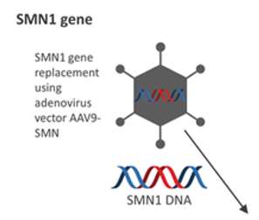
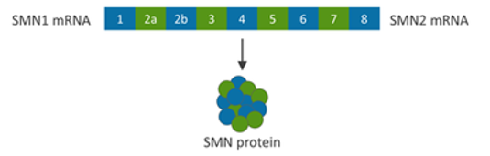
Zolgensma® (onasemnogene abeparvovec)
Mechanism of Action: recombinant AAV9-based (adeno-associated virus vector) gene therapy that delivers a copy of SMN1 gene encoding functional SMN protein
Indication: treatment of pediatric patients less than 2 years of age with SMA with bi-allelic mutations in the SMN1 gene
Dose: 1.1 x 10¹⁴ vector genomes(vg)/kg single-dose intravenous infusion over 60 minutes

Slide 13
Summary of Clinical Studies - Zolgensma
 | START | STR1VE
Design | Phase 1, open-label, dose-finding | Phase 3, open-label, single-arm
# of patients | SMA Type 1, N = 15 | SMA Type 1, N = 22
Avg. Age | 6.3 months / 3.4 months | 3.7 months
Results | High dose group (N = 12): 100% (12 out of 12) not requiring permanent breathing support at 24 months 75% achieved ability to sit for 30 seconds without assistance 16.6% achieved standing/walking independently Low dose group (N = 3): 1 required permanent breathing support None achieved independent sitting, standing or walking | 90.9% (20 out of 22) not requiring permanent breathing support at 14 and 18 months 1 passed away at 7.8 months from unrelated causes to treatment 59% achieved ability to sit for 30 seconds without assistance at 18 months 95% achieved or maintained a CHOP-INTEND score of at least 40 Average increase of 6.9 points
Notes:
Zolgensma has been studied in 2 open-label clinical studies: STR1VE and START. Both clinical studies have been completed. Children in both studies had 2 copies of SMN2 and experienced symptoms prior to the age of 6 months. All children received ZOLGENSMA and there was no placebo used.
STR1VE: Received FDA approved dose: 1.1 x 10 ^14 vg/kg
START: 2 groups: high dose group (12 pts) = btwn 1.1 x 10^14 and 1.4 x 10^14 vg/kg; low dose group (3 pts) = one-third of the dose received by pts in the high dose group

Slide 14
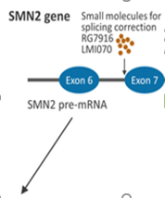
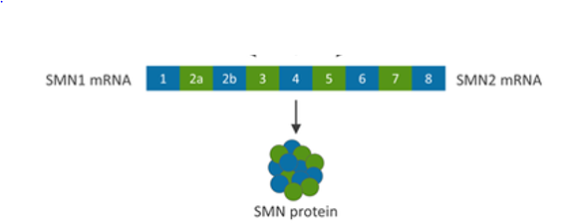
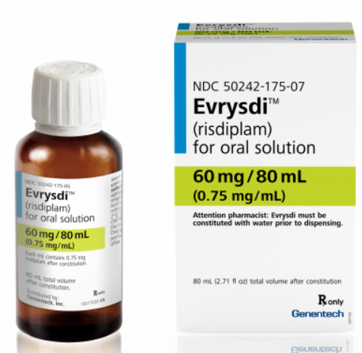
Evrysdi™ (risdiplam)
Mechanism of Action: SMN2 gene splicing modifier that systemically distributes small molecules that enhance exon 7 inclusion into SMN2 messenger ribonucleic acid (mRNA) to produce more functional SMN protein
Indication: treatment of SMA in patients 2 months of age and older
Dose: oral solution administered daily
  0.2 mg/kg for patients 2 months to less than 2 years old
  0.25 mg/kg for patients 2 years of age and older, < 20 kg
  5 mg for patients 2 years of age and older, ≥ 20 kg
Notes:
FDA approved Evrysdi based on data from two phase 3 studies: on positive top-line data from the ongoing Phase 2/3 FIREFISH (NCT02913482) and SUNFISH (NCT02908685) trials.

Slide 15
Summary of Clinical Trials - Evrysdi
 | FIREFISH | SUNFISH | JEWELFISH | RAINBOWFISH
Design | Open-label, 2-part pivotal trial | 2-part, double blind, placebo controlled pivotal trial | Open-label exploratory trial | Open-label, single arm, multicenter study
SMA Population | Type 1 Infants | Type 2-3 2 – 25 years old | SMA (All types) previously treated 6 months – 60 years old | Type 1 Pre-symptomatic Birth to 6 weeks of age
Status | Phase 3 Enrollment part 2 completed 11/2018 | Phase 3 Part 1 data presented June 2020 | Recruitment completed | Currently recruiting
Primary Endpoints | Part 1: Assessing safety profile in infants and dose for Part 2 Part 2: Assessing efficacy by proportion of infants able to sit without support after 12 months of treatment | Part 1: Determined dose for Part 2 Part 2: Evaluated motor function after 12 months of treatment using Motor Function Measure 32 | Assessing safety, pharmacodynamics data, and accessibility in a broad population of patients that have been previously treated | Evaluating efficacy, safety, pharmacokinetics, pharmacodynamics in babies
Notes:
FDA approved Evrysdi based on data from two phase 3 studies: on positive top-line data from the ongoing Phase 2/3 FIREFISH (NCT02913482) and SUNFISH (NCT02908685) trials.
FIREFISH (NCT02913482) – an open-label, two-part pivotal clinical trial in infants with Type 1 SMA. Part 1 was a dose-escalation study in 21 infants with the primary objective of assessing the safety profile of risdiplam in infants and determining the dose for Part 2. Part 2 is a pivotal, single-arm study of risdiplam in 41 infants with Type 1 SMA treated for 24 months, followed by an open-label extension. Enrollment for Part 2 was completed in November 2018. The primary objective of Part 2 was to assess efficacy as measured by the proportion of infants sitting without support after 12 months of treatment, as assessed in the Gross Motor Scale of the Bayley Scales of Infant and Toddler Development – Third Edition (BSID-III) (defined as sitting without support for 5 seconds). The study met its primary endpoint.
SUNFISH (NCT02908685) – SUNFISH is a two-part, double-blind, placebo controlled pivotal study in people aged 2-25 years with Types 2 or 3 SMA. Part 1 (n=51) determined the dose for the confirmatory Part 2. Part 2 (n=180) evaluated motor function using total score of Motor Function Measure 32 (MFM-32) at 12 months. MFM-32 is a validated scale used to evaluate fine and gross motor function in people with neurological disorders, including SMA. The study met its primary endpoint. Most common adverse events in Part 1 of the SUNFISH study were fever (pyrexia; 55%), cough (35%), vomiting (33%), upper respiratory tract infections (31%), cold (nasopharyngitis; 24), and sore throat (oropharyngeal pain; 22%)
Part 1 2-yr data: Results also showed that treatment with risdiplam led to a median two-fold increase in blood SMN protein levels after four weeks, which was sustained for at least 24 months.
JEWELFISH (NCT03032172) – an open-label exploratory trial in people with SMA aged 6 months-60 years who have been previously treated with SMA-directed therapies. The study has completed recruitment (n=174). Most common adverse events were upper respiratory tract infections (13%), headache (12%), fever (8%), diarrhea (8%), nasopharyngitis (7%) and nausea (7%).Among the patients who completed 12 months of treatment with risdiplam, a median two-fold increase in SMN protein versus baseline was observed (n=18). An early assessment of safety showed a consistent safety profile compared to treatment-naive patients. Of the 174 patients enrolled, 76 were previously treated with nusinersen and 14 with onasemnogene abeparvovec. The remaining 83 patients had been treated with compounds then being developed by Genentech.
RAINBOWFISH (NCT03779334) – an open-label, single-arm, multicenter study, investigating the efficacy, safety, pharmacokinetics and pharmacodynamics of risdiplam in babies (~n=25), from birth to six weeks of age (at first dose) with genetically diagnosed SMA who are not yet presenting with symptoms. The study is currently recruiting.

Slide 16
Summary of Clinical Trial Results - Evrysdi
 | FIREFISH | SUNFISH
SMA Population | Type 1 Infants | Type 2-3 2 – 25 years old
Results | Part 1 (N = 21): Median treatment duration 14.8 months [0.6 to 26 months] After 12 months of treatment: Recommended (higher) dose 0.2 mg/kg/day, N = 17: 41% able to sit independently for 5 seconds or more 90% of all patients were alive without permanent ventilation After 23 months of treatment: 81% of all patients were alive without permanent ventilation | Part 2 (N = 180): Type 2 (71%) vs Type 3 (29%) Evrysdi recommended dose vs placebo 2:1 MFM32 score change from baseline at month 12: 1.36 vs -0.19 Proportion of patients with a change from baseline MFM32 total score of 3 or more at month 12: 38.3% vs 23.7% Change from baseline in total score RULM at month 12: 1.61 vs 0.02
Notes:
FIREFISH (NCT02913482) – The results of Part 1 from the FIREFISH trial included 21 patients enrolled in 1 of 2 dosage cohorts. There are 17 pts in the higher dosage (recommended dose) cohort and 4 pts in the low-dosage cohort. Of the higher dosage cohort (pts that received the recommended dose cohort), 41% (7/17) were able to sit independently for 5 or more seconds after 12 months of therapy. 90% of patients were alive without permanent ventilation beyond the expected age of 14 months (and reached 15 months of age or older). After a minimum of 23 months of treatment, 81% of all pts were alive without permanent ventilation (reached an age of 28 months or older; median 32 months; range 28 to 45 months)
SUNFISH (NCT02908685) – The results of Part 2 from the SUNFISH trial included 180 patients. 71% have type 2 SMA and 29% have type 3 SMA and 120 pts received risdiplam while 60 pts received placebo. The MFM32 (Motor Function Measure 32) score change from baseline at month 12 was 1.36 treated vs -0.19 placebo group. The proportion of pts with a change from MFM32 baseline total score of 3 or more at month 12 is 38.3% treated vs 23.7% placebo. RULM change from baseline in total score at month 12 was 1.61 treated vs 0.02 placebo grp. (DO not have to include in audio just additional information: Part 2 data was the only data within the package insert; Part 1 2-yr data: Results also showed that treatment with risdiplam led to a median two-fold increase in blood SMN protein levels after four weeks, which was sustained for at least 24 months).

Slide 17
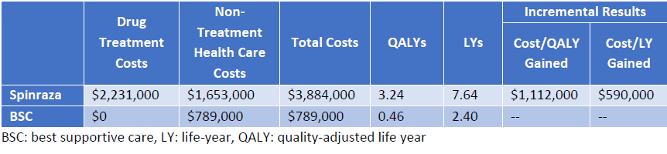
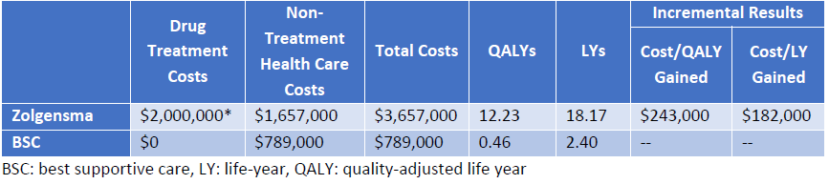
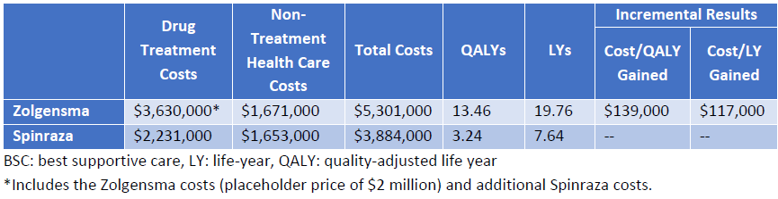
Institute for Clinical and Economic
Review (ICER) Analysis
Analysis published May 2019
  At the time, Zolgensma was not FDA approved
  Specific to SMA Type 1
In the United States, thresholds of $100,000 or $150,000 per QALY gained have been suggested as a reasonable upper bound for an intervention to be deemed cost effective
Zolgensma has an incremental cost-effective ratio of $139,000 per QALY compared to Spinraza
Notes:
ICER developed 3 economic models that evaluated the cost-effectiveness of Spinraza and Zolgensma, each compared to best supportive care. The models included 1) one for symptomatic patients with infantile-onset (Type I) SMA; 2) one for symptomatic patients with later-onset (Type II/III) SMA; and 3) one for presymptomatic SMA patients. Only type 1 SMA evaluation will be discussed in this presentation since both Zolgensma and Spinraza has efficacy data in this population.
At the time of the ICER Analysis, Zolgensma was not yet FDA approved. Clinical Efficacy was taken from the one pivotal Zolgensma study for analysis. ICER determined that both Spinraza and Zolgensma provided clinical benefit
Compared to Supportive Care in type 1 SMA.
The tables on this slide reflects model results from the health care sector perspective. The modified societal perspective analysis produced similar results (not presented in this slide deck).
Both Spinraza and Zolgensma resulted in more QALYs and life years gained relative to BSC, resulting in incremental cost effectiveness ratios of approximately $1.1 million per QALY for Spinraza and approximately $243,000 per QALY for Zolgensma. The cost per life year (LY) gained for Spinraza and Zolgensma were approximately $590,000 and $182,000, respectively. This does not meet the reasonable suggested upper bound for an intervention to be deemed cost effective.
Models for later onset SMA (type 2/3) and presymptomatic SMA specific to Spinraza were not cost-effective (since none of the patients were able to walk as per trial data in this population)

Slide 18
Conclusion
Spinal muscular atrophy has a huge impact on utilization of health care services, durable medical equipment, costs, and caregiver/family care
The development of disease modifying therapies that enhance the production of functional SMN protein has completely changed the way SMA is approached and treated
Impact of novel agent Evrysdi to be seen:
  Utilization of Spinraza and Zolgensma
  Patients previously treated with SMN enhancing therapy
  Development of future agents for the treatment of SMA
Overall efficacy and cost of treating SMA

Slide 19
Glossary
ADL – Activities of Daily Living
CHOP-INTEND – Children’s Hospital of Philadelphia Infant Test of Neuromuscular Disorders
CNS – Central Nervous System
HFMS(E) – Hammersmith Functional Motor Scale (Expanded)
HINE – Hammersmith Infant Neurological Examination
ICER – Institute for Clinical and Economic Review
MFM32 – Motor Function Measure 32 motor function test
MOA – Mechanism of Action
QALY – Quality Adjusted Life Years
RULM – Revised Upper Limb Module
SMA – Spinal Muscular Atrophy
SMN – Survival Motor Neuron
ULM – Upper Limb Module

Slide 20
References
https://www.ncbi.nlm.nih.gov/books/NBK533981/ (Accessed August 7, 2020).
https://www.avexis.com/us/Content/pdf/prescribing_information.pdf (Accessed July 31, 2020).
https://www.zolgensma.com/clinical-studies (Accessed August 2, 2020).
https://www.spinraza.com/content/dam/commercial/spinraza/caregiver/en_us/pdf/spinraza-prescribing-information.pdf (Accessed July 31, 2020).
https://www.spinraza.com/en_us/home/why-spinraza/later-onset-studies.html (Accessed August 2, 2020)
https://icer-review.org/material/sma-final-evidence-report (Accessed July 31, 2020).
https://pubmed.ncbi.nlm.nih.gov/30044619/ (Accessed July 31, 2020).
https://www.curesma.org/risdiplam/ (Accessed July 31, 2020).
https://www.agah.eu/wp-content/uploads/Mueller__Lutz.pdf (Accessed July 31, 2020).
https://www.gene.com/download/pdf/evrysdi_prescribing.pdf (Accessed August 24, 2020).
https://www.uptodate.com/contents/spinal-muscular-atrophy?source=mostViewed_widget#H2206210403 (Accessed July 31, 2020).

